Slide 1



JavaScript as excaminor
For Tony`s Pizza

Slide 2
Overview
JS validation for
Email
Required
Max count
Additional information for user
Phone number analysier

Slide 3
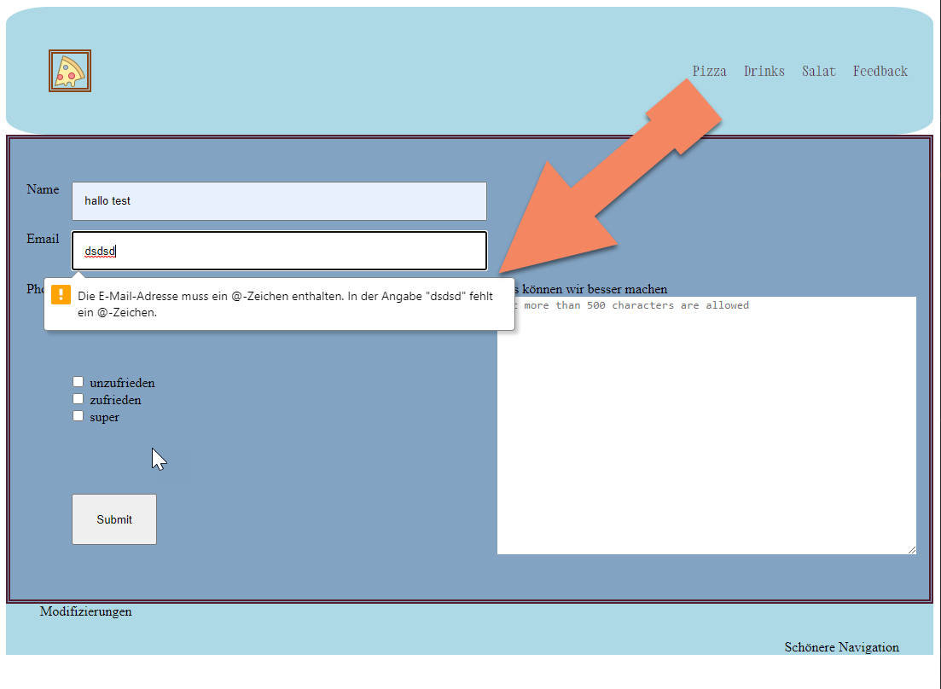
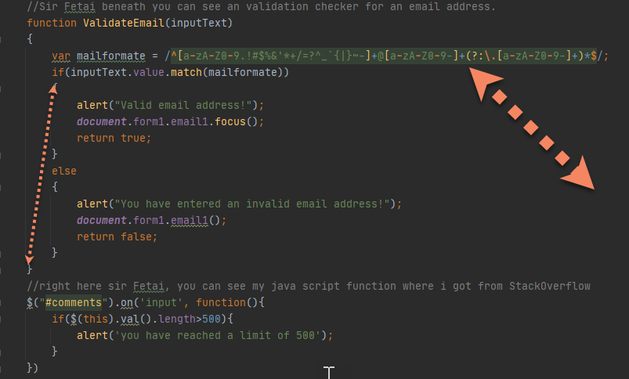

E-Mail
Important word match
User’s view

Slide 4
How works the E-Mail form
1.Email contains an @ +personal info +domain
2.Personal info may up to 64 characters
May be uppercase or lowercase
Digits 0-9
!#$%&’/?^_{|}~
A dot can’s be the first oder last character

Slide 5
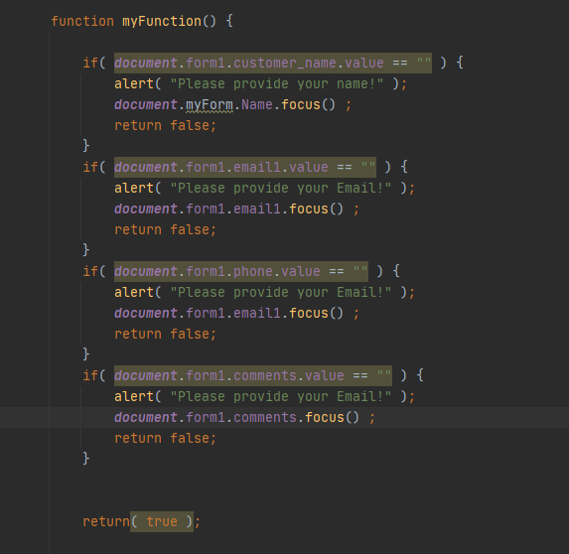
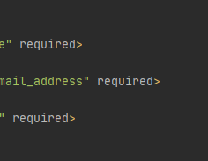
Required inputfields
Set for each inputfield a variable JS
Did add en attribute aswell in the html
Html and Javascript

Slide 6
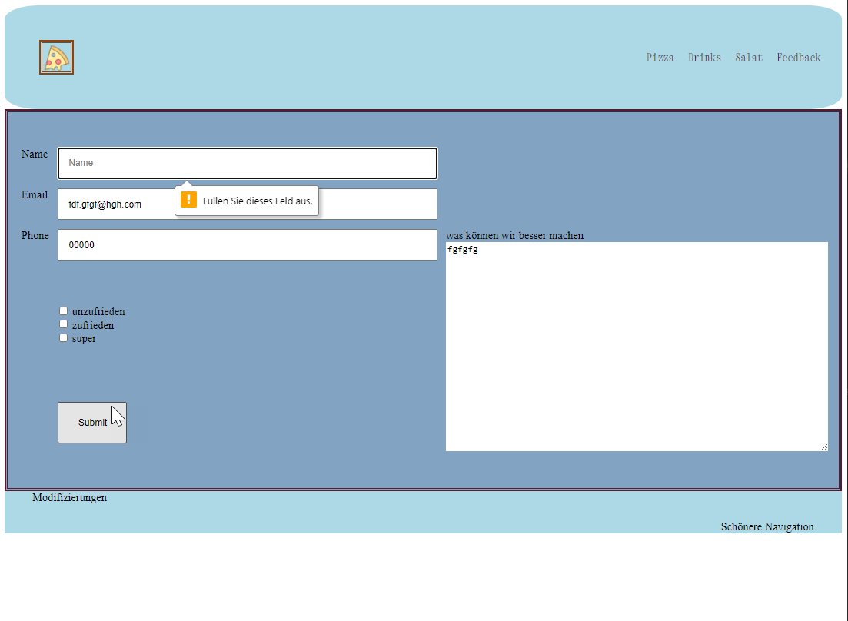
Validation for the required
With the if clouses I check if at least one character is in.
And this conditions checks all fields

Slide 7
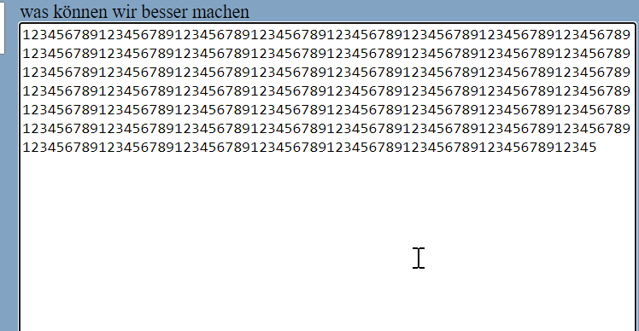
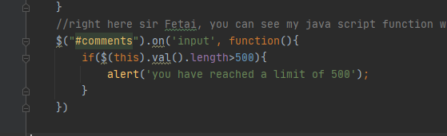
Maximal number of characters
It stops by 500 digits

Slide 8
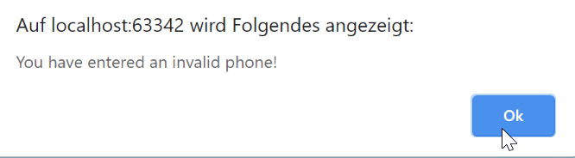
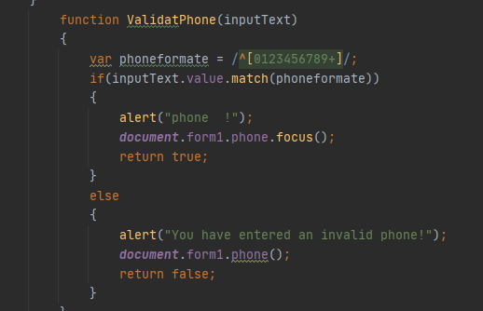
Made a few adjustments
This show’s up when an invalid phone has entred

Slide 9

Your Welcome

